Slide 1

CHAPTER 1
INTRODUCTION TO ECONOMICS

Slide 2
Learning Outcomes
AFTER READING THE WHOLE CHAPTER, THE STUDENT IS EXPECTED TO BE ABLE TO:
Define economics and distinguish between microeconomics and macroeconomics
Describe basic economic concepts: scarcity, choices and opportunity cost
Use the production possibilities curve to explain the basic economic concepts

Slide 3
WHAT IS ECONOMICS?
A science that studies human behavior as a relationship between ends and scarce means which have alternative uses.’
limited resources
unlimited wants
The study of how people satisfy wants with scarce resourse

Slide 4

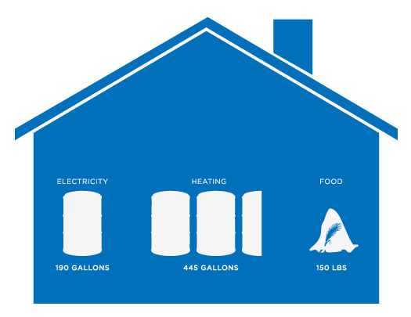

MICROECONOMICS VS MACROECONOMICS
  MICROECONOMIC
Microeconomics focuses on the individual parts of the economy.
How households and firms make decisions and how they interact in specific markets
INDIVIDUAL
HOUSEHOLD
FIRMS

Slide 5
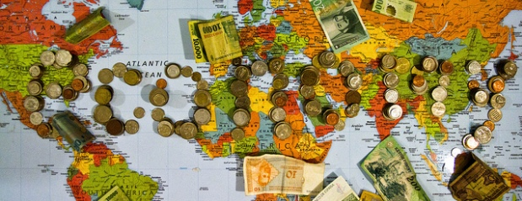
  MACROECONOMIC
Macroeconomic looks at the economy as a whole.
Economy-wide phenomena, including inflation, unemployment, and economic growth

Slide 6
BASIC ECONOMIC CONCEPTS
SCARCITY
CHOICES
OPPORTUNITY COST
BASIC
ECONOMIC
CONCEPTS

Slide 7
SCARCITY
Unlimited wants
Unlimited wants
The condition in which our wants (for goods) are greater than the limited resources
We want goods, but there are just not enough resources available to provide us with all the goods we want
SCARCITY
Choices
WHAT to produce
HOW to produce
FOR WHOM to produce

Slide 8

What to Produce?
The economy of every nation has to take a fundamental decision of what to produce because of the limited economic resources
Depends on the what type of goods and services to produce

Slide 9
How To Produce
Depends on the cheapest method of production
There are alternative techniques of producing goods and services

Slide 10
For Whom To Produce
Depends on the distribution of income
Example: Who will drive the latest model of an imported car

Slide 11

RESOURCES

Slide 12
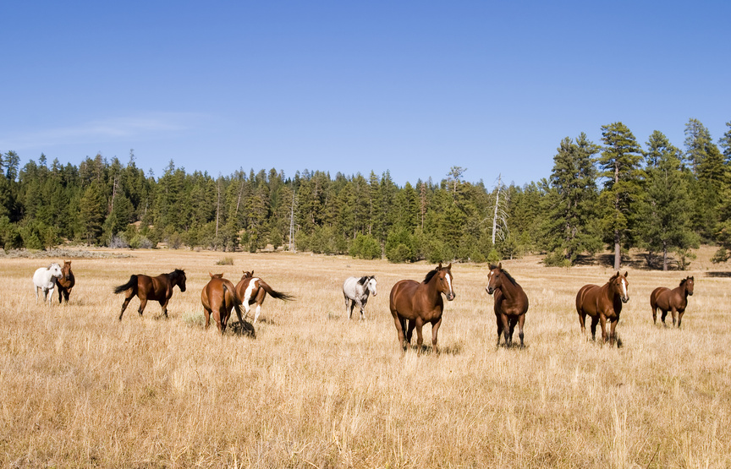
LAND

Slide 13

LABOR

Slide 14

CAPITAL
CAPITAL
“the tools, buildings and equipment used to produced goods and services”

Slide 15


ENTREPRENEUR
“human activity organizing resources into production”
“reap gains from the profits of their production”
“face risks from decisions”

Slide 16

PRODUCTION POSSIBILITIES FRONTEIR (PPF)

Slide 17
PRODUCTION POSSIBILITIES FRONTEIR (PPF)
The PPF shows various possible combination of goods or services produced within a specified time with its resources fully and efficiently employed.

Slide 18
All production possibilities frontiers have two characteristics in common:
♦ Production points inside and on the PPF are attainable. Points beyond the PPF are not attainable.
♦ Production points on the PPF achieve production efficiency because more of one good can be obtained only by producing less of the other good. Production points inside the PPF are inefficient, with misallocated or unused resources.

Slide 19
PRODUCTION POSSIBILITIES (CON’T)
Defence Goods (million)
North Korea produces two products—defence goods and consumer goods
If it allocates its resources to defence goods, it will produce at Point A
If it allocates its resources to consumer goods, it will produce at
Point F
A
150
B
120
C
If North Korea is at point C on the PPC, it can produce the combination of 120 million defence goods and 20 million units of consumer goods
Point D shows production of 90 million defence goods and 30 million units of consumer goods
D
90
60
E
30
F
Consumer Goods (million)
0
10
20
30
40
50

Slide 20
PRODUCTION POSSIBILITIES CURVE (PPC) (CON’T)
Defence Goods (million)
Point outside the PPC (Point Z) ➔ SCARCITY
Z
150
A
B
UNATTAINABLE
C
Point along the PPC ➔ CHOICES
120
Y
D
90
Movement from one point to another (point C to D) ➔ OPPORTUNITY COST
ATTAINABLE
60
Point inside the PPC (Point Y) ➔ Waste of resources and inefficiency
E
30
F
0
Consumer Goods (million)
10
20
30
40
50

Slide 21

Figure 2 The Production Possibilities Frontier
Quantity of
Computers
Produced
3,000
D
2,200
C
2,000
A
Production
possibilities
B
frontier
1,000
0
300
600
700
1,000
Quantity of
Cars Produced
Copyright©2003 Southwestern/Thomson Learning

Slide 22


OPPORTUNITY COST
The cost of the next best alternative among a person’s choices
Sacrifices

Slide 23
The Circular-Flow Diagram
The circular-flow diagram is a visual model of the economy that shows how dollars flow through markets among households and firms.

Slide 24
The Circular Flow
MARKETS
Revenue
FOR
Spending
GOODS AND SERVICES
Goods
Firms sell
Goods and
and services
Households buy
services
sold
bought
FIRMS
HOUSEHOLDS
Produce and sell
Buy and consume
goods and services
goods and services
Hire and use factors
Own and sell factors
of production
of production
Factors of
MARKETS
Labor, land,
production
FOR
and capital
FACTORS OF PRODUCTION
Wages, rent,
Households sell
Income
and profit
Firms buy
= Flow of inputs
and outputs
= Flow of dollars
Copyright © 2004 South-Western

Slide 25
Firms
Produce and sell goods and services
Hire and use factors of production
Households
Buy and consume goods and services
Own and sell factors of production

Slide 26
Markets for Goods and Services
Firms sell
Households buy
Markets for Factors of Production
Households sell
Firms buy
Factors of Production
  Inputs used to produce goods and services
  Land, labor, and capital

Slide 27
SUMMARY
Economists try to address their subjects with a scientist’s objectivity.
  They make appropriate assumptions and build simplified models in order to understand the world around them.
  Two simple economic models are the circular-flow diagram and the production possibilities frontier.

Slide 28
SUMMARY
Economics is divided into two subfields:
  Micro economists study decision-making by households and firms in the marketplace.
  Macroeconomists study the forces and trends that affect the economy as a whole

