Slide 1
Special Parts of Business Letters
Career Prep
2013-2014

Slide 2
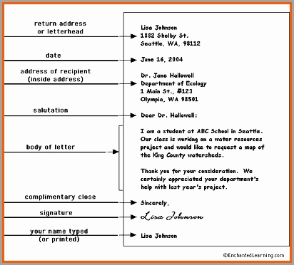

Slide 3
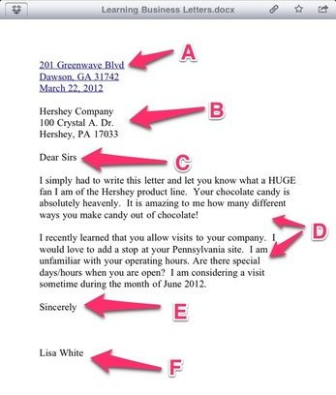

Slide 4
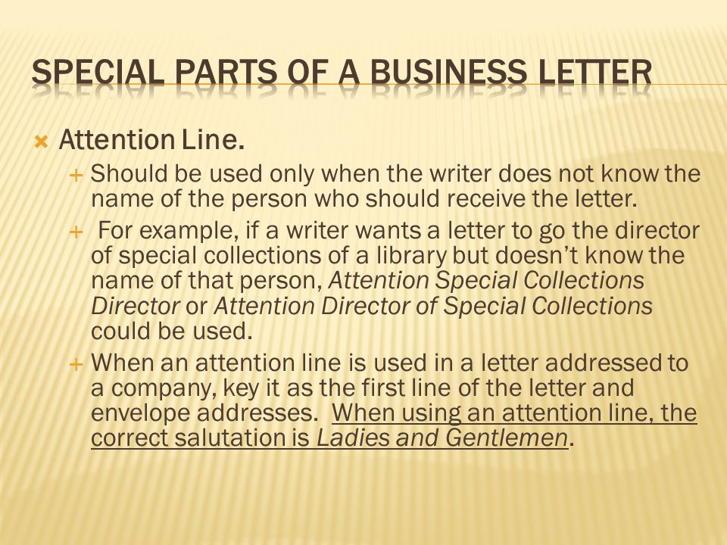

Slide 5
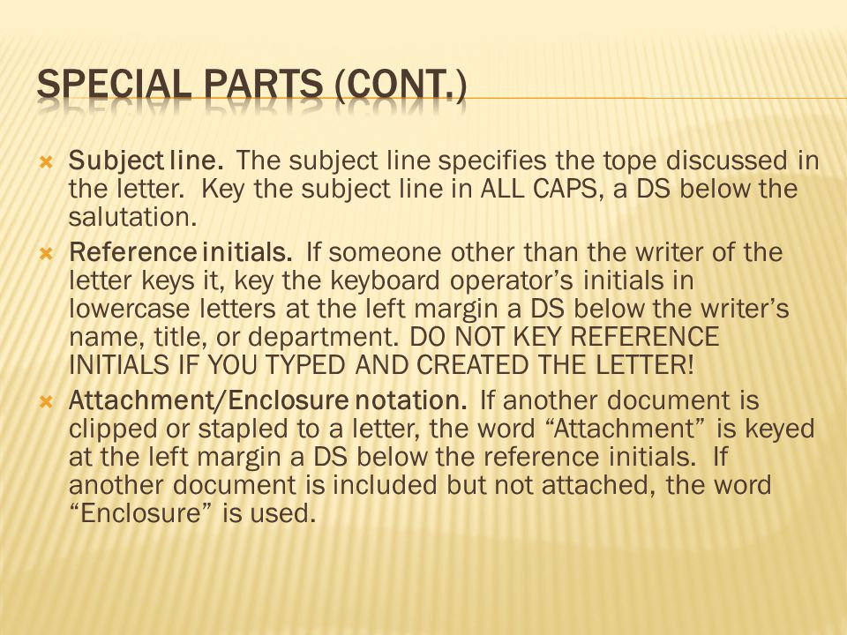

Slide 6
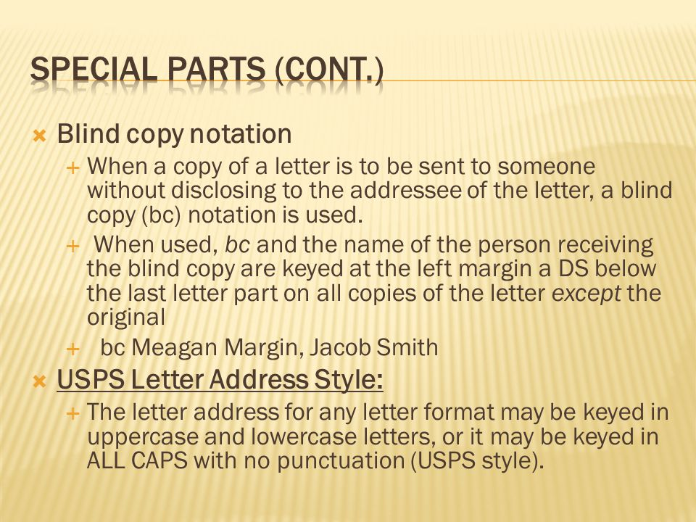

Slide 7
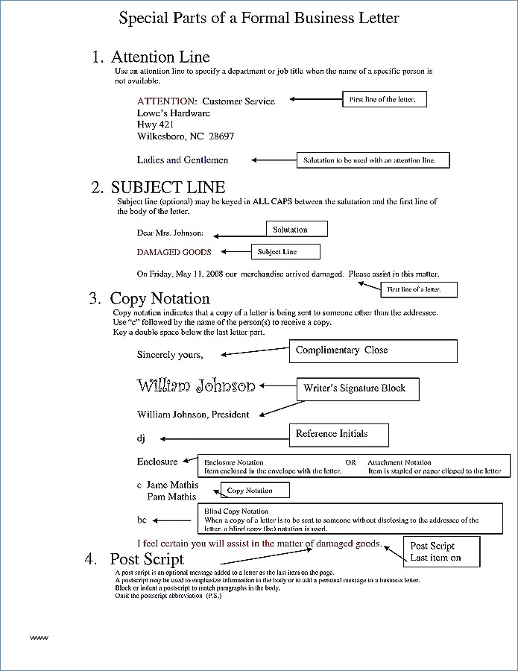

Slide 8
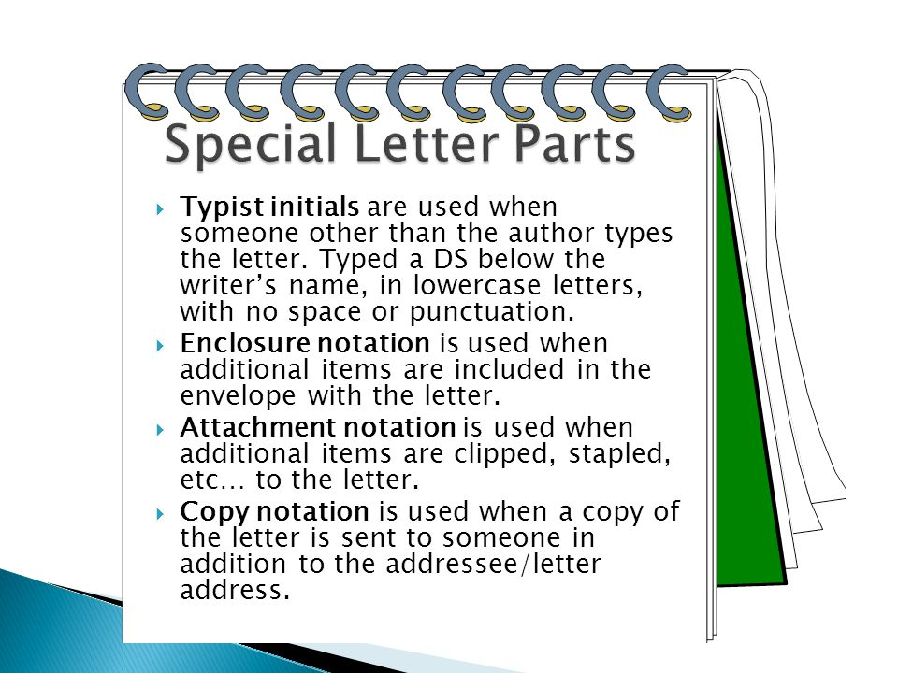

Slide 9
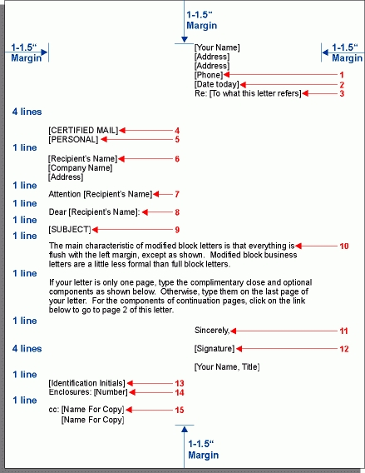

Slide 10
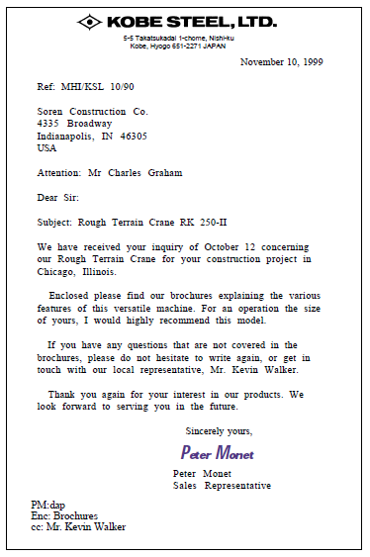

Slide 12
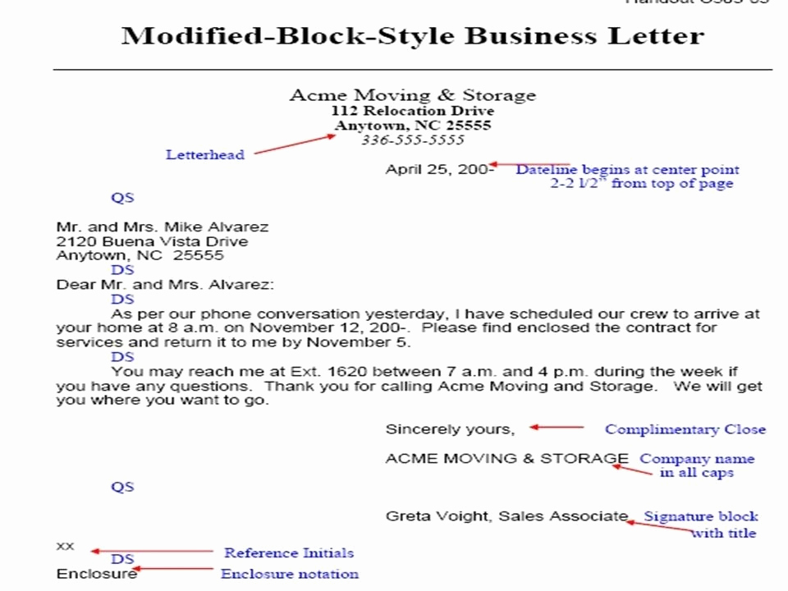

Slide 14
Attention Line
An attention line should be used only when the writer does not know the name of the person who should receive the letter.

Slide 15
Subject Line
The subject line specifies the topic discussed in the letter.
Key the subject line in ALL CAPS, a DS below the salutation.

Slide 16
Reference Initials
If someone other than the originator of the letter keys it
Key the keyboard operator’s initials in lowercase letters at the left margin a DS below the writer’s name, title, or department.

Slide 17
Attachment/Enclosure Notation
If another document is clipped or stapled to a letter, the word “Attachment” is keyed at the left margin a DS below the reference initials.
If another document is included but not attached, the word “Enclosure” is used.
If reference initials are not used, Attachment or Enclosure is keyed a DS below the writer’s name.

Slide 18
Copy Notation
A copy notation indicates that a copy of a letter is being sent to someone other than the addressee.
Use “c” followed by the name of the person(s) to receive a copy.
Place a copy notation a DS below the enclosure notation or the reference initials if there is no enclosure:
Example: c Hector Ramirez

Slide 19
Blind Copy Notation
When a copy of a letter is to be sent to someone without disclosing to the addressee of the letter, a blind copy (bc) notation is used.
When used, bc and the name of the person receiving the blind copy are keyed at the left margin a DS below the last letter part on all copies of the letter except the original.
Example: bc Arlyn Hunter

Slide 20
Second-Page Heading
Occasionally, a letter (or memo) will be longer than one page.
Only p. 1 is keyed on letterhead; all additional pages should be keyed on plain paper with a second-page heading.
Key the heading 1” from the top of the page SS in block format at the left margin.
Include the name of the addressee, the page number, and the date.
DS below the date before continuing the letter.

