Slide 1
Accounts of Limited liability Companies
The following is a trial balance of Obama’s as on 31 December 2003
Dr. Cr.
$ $
Share Capital Issued: Ordinary shares $1 75, 000
Debtors and Creditors 28, 560 22, 472
Stock 31 Dec. 2002 41, 415
Bank 16, 255
Machinery(cost) 45, 000
Motor Vehicles(cost) 28, 000
Depreciation Provisions Dec. 31. 2002
Machinery 18, 000
Motor Vehicle 12, 600
Sales 97, 500
Purchases 51, 380
Motor Expenses 8, 144

Slide 2
Trial Balance continued
Dr. Cr.
$ $
Repairs to Machinery 2, 308
Sundry Expenses 1, 076
Pay 11, 372
Director’s remuneration 6, 200
Profit and loss account as at 31 Dec., 2002 6, 138
General reserve 8, 000
239, 710 239, 710
Given the following information, you are to draw up the trading and profit and loss accounts for the year ended 31 December, 2003 and a balance sheet as at that date.
Authorised share capital $100, 000 in ordinary shares $1
Stock at 31 Dec. 2003, $54, 300
Motor expenses owing $445
Ordinary Dividend proposed of 20%
Transfer $2, 000 to general reserve
Provide for depreciation of all fixed assets at 20% reducin balance method
Ignore taxation

Slide 3
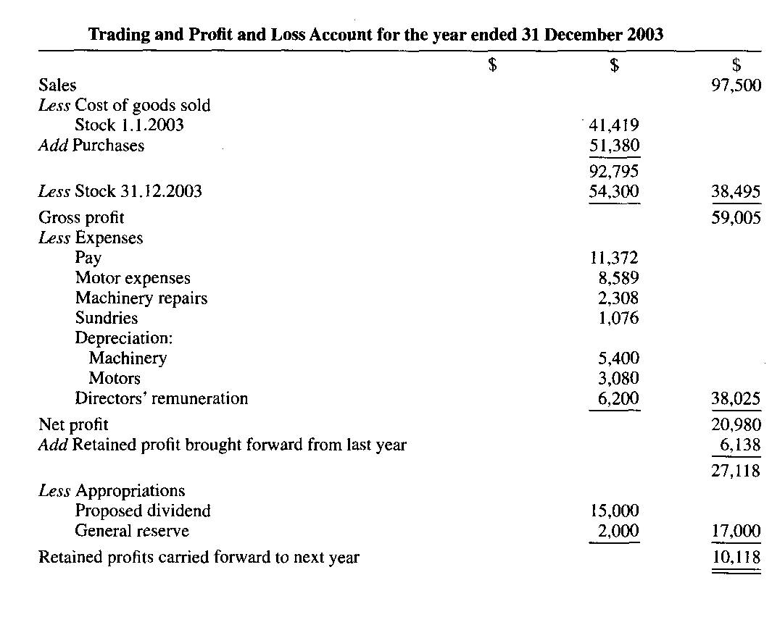
Solution 1

Slide 4
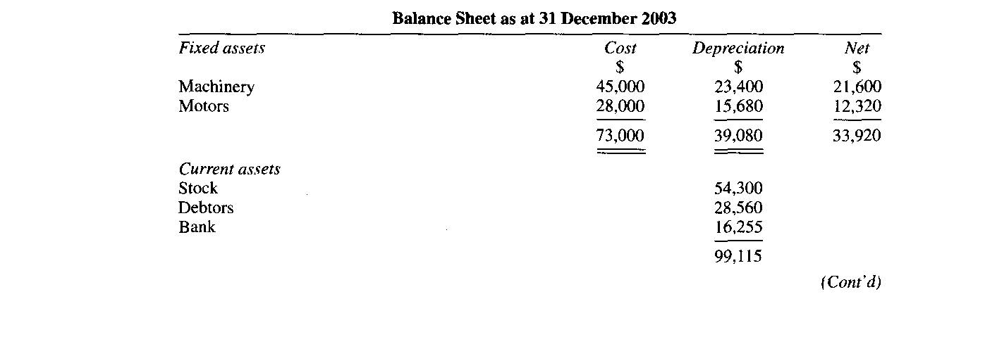
Solution 2

Slide 5
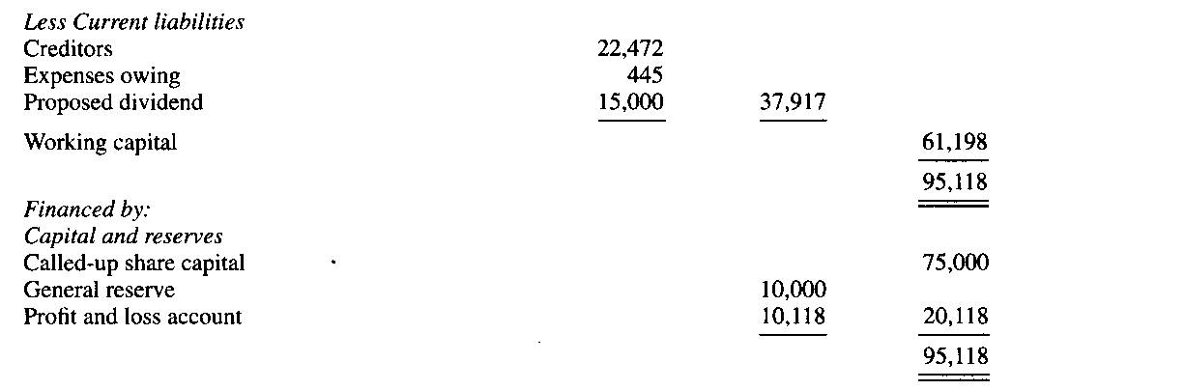
Solution 3

